Slide 1

SathiSahyogi
Decentralized Crowdfunding
By~ Vidit Kulshrestha
E22BCAU0034

Slide 2
Problem Statement:
Finding reliable causes to support and effectively communicating needs are common challenges in fundraising. Without a centralized platform, donors struggle to locate authentic events, while beneficiaries find it hard to share their stories. This lack of transparency leads to distrust and limits the impact of donations. "Sathisahyogi" simplifies this process by offering an easy-to-use web platform connecting donors with trustworthy events and empowering beneficiaries to transparently communicate their needs. The goal is to build trust, transparency, and impactful support within communities.

Slide 3

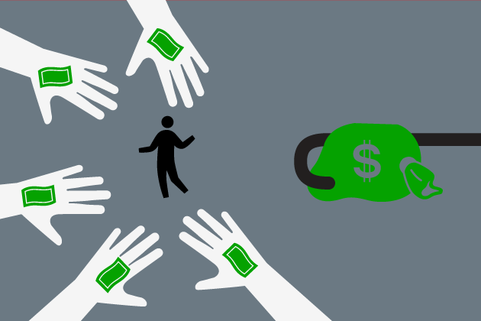
What is charity crowdfunding?
Crowdfunding is an event of funding a project or a campaign online by collecting small amounts of money from a large volume of people.
In Charity Crowdfunding beneficiary is not expected to give anything in return.
Example: Community temple, Central Park, School, Startup, Health

Slide 4
Existing Projects
BitGive donation project
Alice crowdfunding platform
BitGive: the first blockchain nonprofit for better giving
See where your money goes and how it helps in real time
No middlemen, no hidden fees
Just pure and simple donations
Alice helps charities raise funds online
It uses Ethereum blockchain and smart contracts
It only sends money to the charities when they achieve their goals
It lets donors get their money back if the goals are not met by the deadline

Slide 5
Existing Research Paper
Blockchain Charity Projects and Their Philanthropic Benefits
This article talks about how blockchain technology helps increasing transparency between donor and beneficiary for charity projects.
Decentralized Application for CharityOrganization Crowdfunding using Smart Contract and Blockchain
This document discusses how blockchain technology can improve the crowdfunding model by using smart contracts and decentralized platforms.
Research on Charity System Based on Blockchain
This project uses Ethereum technology and collect funds on reward based Crowdfunding.

Slide 6
Why SathiSahyogi?
How SathiSahyogi improves trust of donor?
By incorporating blockchain into recording charitable donations, donors will be able to track exactly where their donations go and when they are put into use. SathiSahyogi will provide greater transparency behind nonprofit organizations and give both donors and operators greater accountability when it comes to how donations are spent.
With large, centralized charities, there is always the possibility that too many levels of management will eat into their funds. With SathiSahyogi, the number of middlemen between donors and those they want to help is brought to a minimum, which allows a greater portion of donations to be given to those in need. And donor will be able be track when and where his charity was used.

Slide 7
Admin
Donor
Benefitiary
Fund Raising | Fund Raising
payable | address
totalFundRaised | uint
totalFundReq | uint
totalDonor | uint
totalVote | uint
votingEndTime | uint
totalAsk | uint
fundClaimed | bool
votingStatus | bool
Entites
Function List | Function List
Depositfund | int
Check_contract_balance | int
startVoting | int
putVote | int
claimFund | Int
State Variable | State Variable
Title | String
Required Amount | Int
Benefitiary | String
Story | Varchar
Recieved Amount | Int

Slide 8
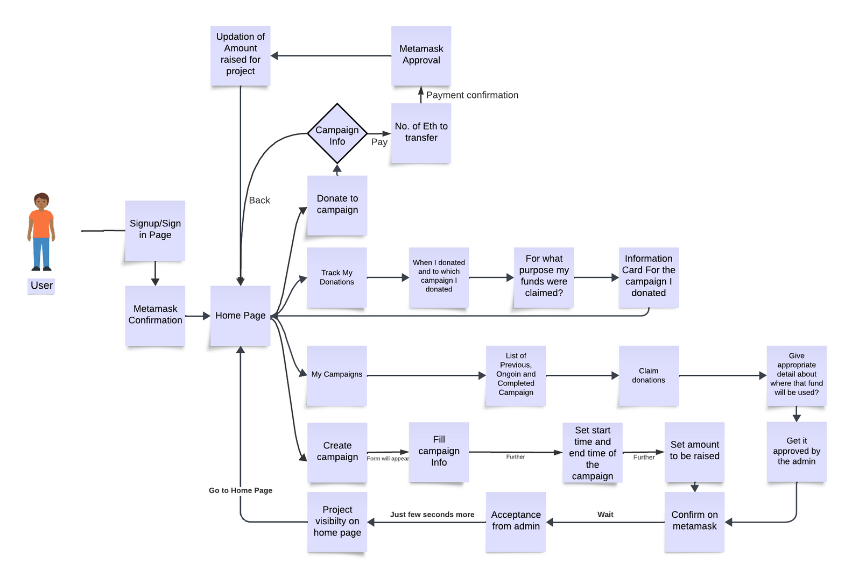
Frontend Flowchart
User Interface Flowchart
The process for donating to a campaign and managing campaigns on the platform involves several steps: - Selecting the amount of Ethereum to transfer - Confirming the payment through Metamask - Updating the amount raised for the project - Donating to the campaign - Signing up or signing in to the platform - Confirming the donation through Metamask - Tracking donations and their purpose - Requesting acceptance from the admin - Displaying the project on the home page - Providing an information card for the campaign - Setting the start and end time of the campaign - Confirming the campaign through Metamask - Filling out campaign information - Getting campaign approval from the admin - Providing details about where the funds will be used - Claiming donations
*Flowchart can be seen by clicking here.

Slide 9
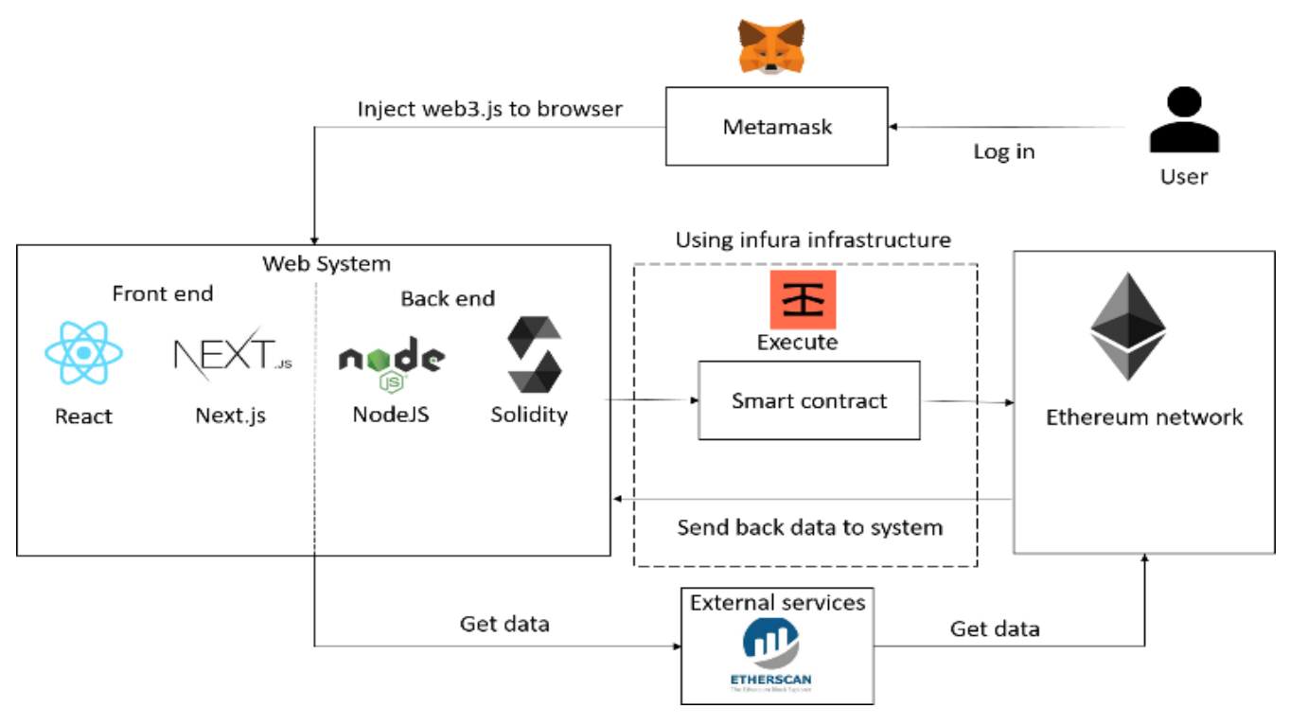

Backend Flowchart

Slide 10
Refrences
Blockchain Charity Projects and Their Philanthropic Benefits | Blockchain-Based Crowdfunding
BitGive Foundation | Crowdfunding for Nonprofits: Top Strategies & Tactics

